Slide 1
Features in Computer Vision Part-2
Feature Matching and Tracking
Computer Vision, 6th Semester, 2024

Slide 2
Feature Matching

Slide 3
Concept
Process of comparing and identifying corresponding features in different images or frames.
Features are distinctive points or patterns in an image that can be used for tasks such as object recognition, image stitching, and motion tracking.
Matching these features is crucial for various computer vision applications.

Slide 4
Essentials in Feature Matching
Keypoints and Descriptors:
Keypoints – specific points in an image that are likely to be distinctive and can be easily located in different views of the same scene.
Descriptors – numerical representations of the local image region around a keypoint, getting information about region appearance.
Feature Detection and Extraction:
Feature detection involves identifying keypoints in an image.
Feature extraction is the process of generating descriptors for the detected keypoints.
Feature Matching Algorithms:
Once keypoints and descriptors are obtained for two images, the next step is to match corresponding features.
Nearest-neighbor matching:
Each keypoint in one image is matched to its nearest neighbor in the other image based on descriptor similarity.
Ratio test: used to filter out ambiguous matches by comparing the distances between the nearest and second-nearest neighbors.
RANSAC (Random Sample Consensus):
After initial feature matching, outliers and incorrect matches may still be present.
RANSAC – used to estimate a model from a set of data that may contain outliers.
RANSAC iteratively selects subsets of matches, fits a model, and evaluates its performance, keeping the best-fitting model.

Slide 5
Feature Matching Methods
Nearest-Neighbor Matching:
Each keypoint in one image is matched to its nearest neighbor in the other image based on descriptor similarity.
Ratio Test:
Used in conjunction with nearest-neighbor matching to filter out ambiguous matches.
It involves comparing the distance between the nearest and second-nearest neighbors.
FLANN (Fast Library for Approximate Nearest Neighbors):
A library that provides efficient implementations of approximate nearest-neighbor algorithms.
DAISY and Dense DAISY:
A dense descriptor that captures information from local image patches.
ORB-SLAM:
Simultaneous Localization and Mapping, with ORB features for mapping and localization in real-time.
Deep Learning-based Approaches:
Siamese Networks and Triplet Networks (designed for learning similarity between pairs of images directly)
SuperPoint and SuperGlue (simultaneously detect keypoints and perform feature matching)

Slide 6
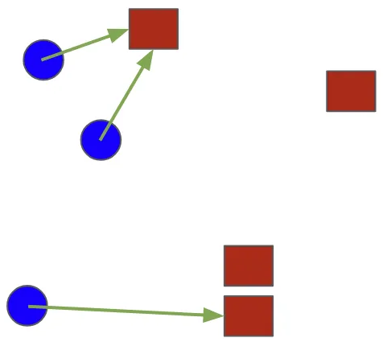
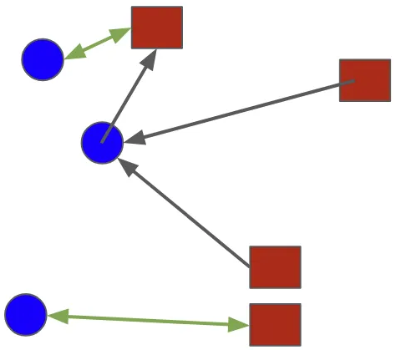
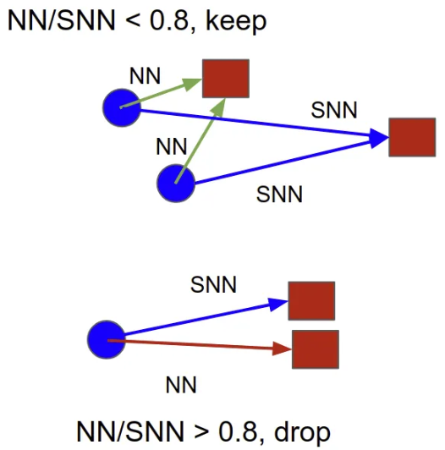
Nearest Neighbor Matching and Ratio Test
Second Nearest Neighbor Matching – Ratio Test
Nearest Neighbor Matching
Mutual Nearest Neighbor Matching

Slide 7
SLAM – Simultaneous Localization And Mapping
STEPS:
Sensor Data Acquisition
Feature Detection and Matching
Motion Estimation
Map Initialization and Point Triangulation:
Initialize the map with the first set of detected features and their 3D positions.
Use triangulation to estimate the 3D position of features by combining information from multiple camera views.
Pose Estimation
Loop Closure Detection:
Identify when the device revisits a location it has visited before, to correct accumulated errors and refine both the map and the device's pose.
Optimization
Continuous map updation (new detected features/environment)
Online (real-time) or Offline (aggregate retrospective) Processing
Integration of Data from Multiple Sensors (if available)
Localization Confidence Assessment
Visualization (optional)
Set of methods used to enable a visual sensor device to simultaneously:
Create a map of its environment
Determine its own position within that environment in real-time
Goal:
To enable a system to navigate and understand its surroundings autonomously without relying on external positioning information.

Slide 8
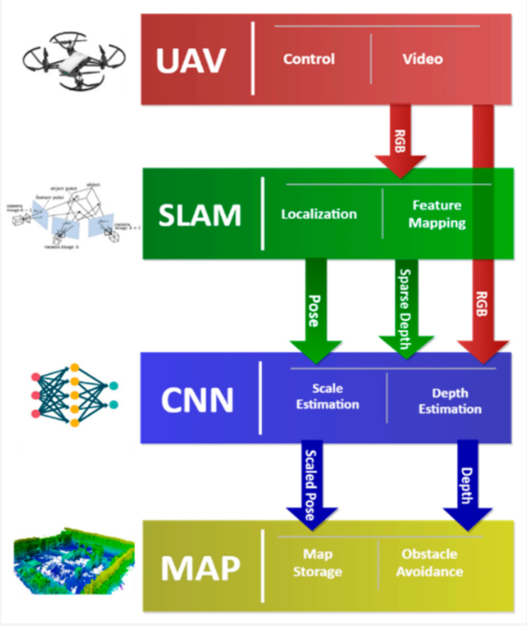
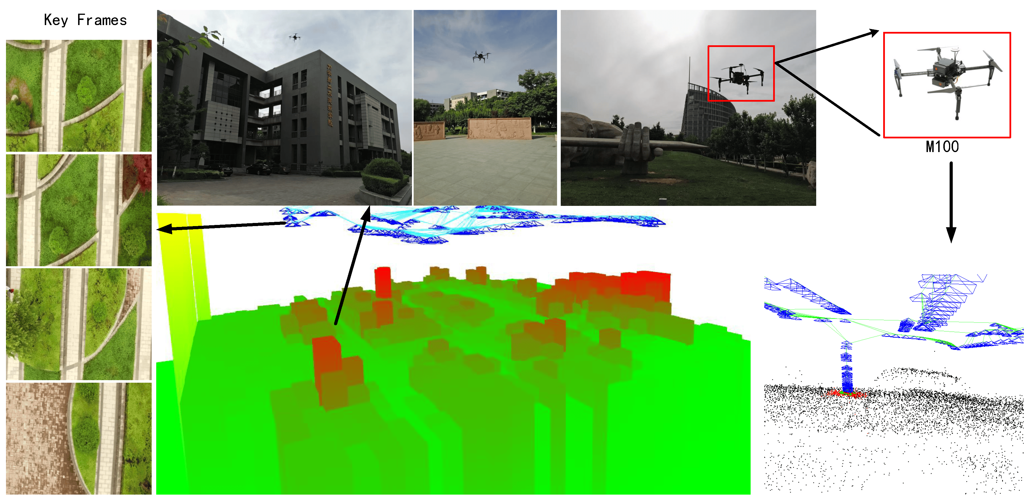
SLAM – Simultaneous Localization And Mapping
Paper:
Steenbeek A, Nex F. CNN-Based Dense Monocular Visual SLAM for Real-Time UAV Exploration in Emergency Conditions. Drones. 2022; 6(3):79. https://doi.org/10.3390/drones6030079
Paper:
Yang T, Li P, Zhang H, Li J, Li Z. Monocular Vision SLAM-Based UAV Autonomous Landing in Emergencies and Unknown Environments. Electronics. 2018; 7(5):73. https://doi.org/10.3390/electronics7050073

Slide 9
Applications
Object Recognition:
Feature matching is essential for recognizing objects in images and videos.
Image Stitching:
Aligning and combining multiple images to create a panoramic view requires accurate feature matching.
Motion Tracking:
Matching features between consecutive frames helps in tracking the movement of objects over time.
Deep Learning Approaches:
Convolutional Neural Networks (CNNs) have been increasingly used for feature extraction and matching in an end-to-end manner.
Siamese networks and triplet networks are architectures designed for learning similarity between pairs of images directly.

Slide 10
Feature Tracking

Slide 11
Concept
Technique used to follow specific points or features in a sequence of images or video frames.
The goal is:
Identify and track these distinctive points across frames
Application:
Motion, object tracking, and other relevant applications.

Slide 12
Essentials
Feature Points:
Feature points are distinctive locations in an image that can be easily identified and tracked over time.
Point Detection:
Features need to be detected in the initial frame before they can be tracked.
Feature Matching:
Once detected in the initial frame, these points are next matched in subsequent frames.
Matching involves finding points in the new frame that correspond to the points in the previous frame.
Motion Estimation:
Feature tracking is often used to estimate the motion between frames.
This can include translation, rotation, scaling, and other transformations.
Tracking Algorithms:
E.g. Kanade-Lucas-Tomasi (KLT) tracker, Lucas-Kanade method
Usage of mathematical models to estimate the movement of features based on their positions in consecutive frames.

Slide 13
Steps in Feature tracking
Initialization:
Select initial feature points in the first frame.
Feature Detection:
Detect feature points in subsequent frames.
Feature Matching:
Match the detected features in the current frame to those in the previous frame.
Motion Estimation:
Estimate the motion parameters (translation, rotation, etc.) between frames.
Update:
Update the positions of feature points for the next frame.

Slide 14
Feature Tracking Methods
Lucas-Kanade Method:
An optical flow method that assumes local affine motion in small image neighborhoods.
Kanade-Lucas-Tomasi (KLT) Feature Tracker:
An extension of the Lucas-Kanade method that incorporates the Harris corner detection algorithm for feature extraction.
KLT Tracker (Pyramid Lucas-Kanade):
A variation of the Lucas-Kanade method that operates on image pyramids, allowing it to handle large displacements and scale changes.
Mean-Shift Tracking:
Popular method for tracking regions of interest in images.
Often applied in object tracking.
Deep Feature Tracking with Neural Networks:
Deep learning architectures learn feature representations and track objects across frames.
E.g. Siamese networks.

Slide 15
Lucas-Kanade Method
Widely used differential method for optical flow estimation
Optical/optic flow:
Pattern of apparent motion of objects, surfaces, and edges in a visual scene caused by the relative motion between an observer and a scene.
Distribution of apparent velocities of movement of brightness pattern in an image.
Estimate the motion of pixels between two consecutive frames in a sequence of images or a video
Assumes that the motion is essentially constant within a local neighborhood of the image

Slide 16

Lucas-Kanade Method: Steps
Gradient Computation:
Compute the spatial gradients ($I_{x} and I_{y}$) of the image with respect to x and y (spatial coordinates).
Temporal Gradient Calculation:
Compute the temporal gradient ($I_{t}$) between consecutive frames.
Local Window Setup:
Choose a local window around each pixel to define the region for motion estimation.
Least Squares Solution:
For each pixel in the local window, solve the linear system of equations using the least squares method to estimate the motion vector (u,v).
Motion Field Estimation:
Repeat the process for all pixels in the image, resulting in a dense motion field representing the estimated motion vectors at each pixel.

Slide 17
Kanade-Lucas-Tomasi (KLT) Feature Tracker
Extension of the Lucas-Kanade method
Incorporates the Harris corner detector to select key features for tracking
Particularly well-suited for tracking points in images with intensity variations
Applicable to various computer vision tasks:
Object tracking
Motion estimation
Structure from Motion

Slide 18
KLT Tracker: Steps
Detect key features using the Harris corner detector in the first frame
Track features across subsequent frames
Matching based on local intensity patterns
Estimate the motion of each tracked feature using the Lucas-Kanade method
Consideration: spatial and temporal intensity gradients
Update the positions of the tracked features for the next frame
Basis: estimated motion
Repeat the tracking process for each frame in the video sequence

Slide 19
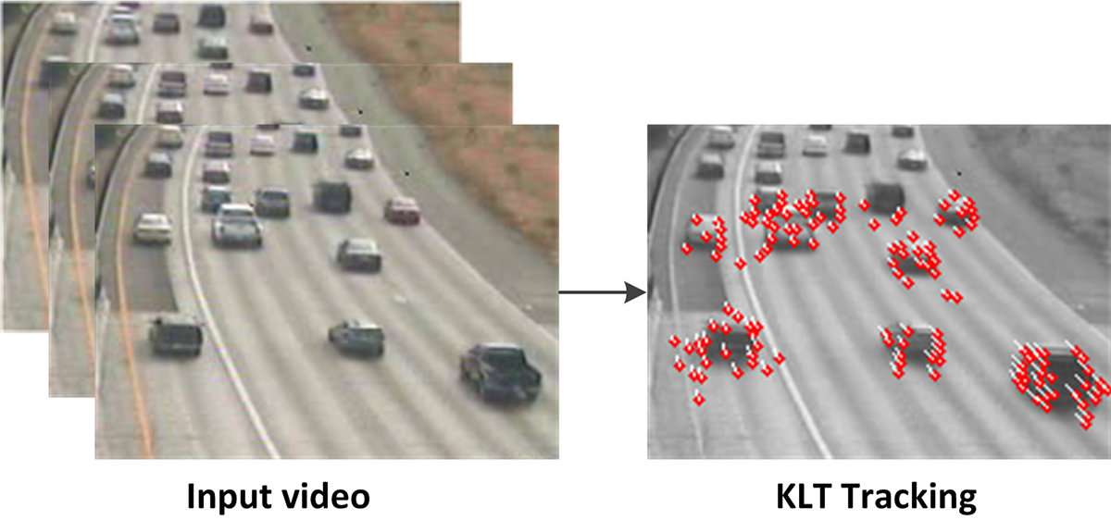
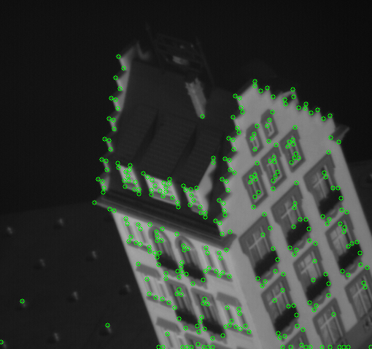
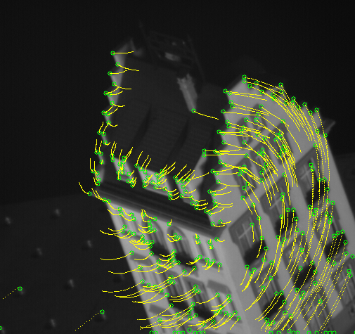
KLT Tracker
Video Input and Tracking Output
Harris Corner Detection
Motion/Feature Tracking

Slide 20
Pyramid KLT Tracker
Extension of KLT Tracker
Incorporates a pyramid representation of the image to handle scale variations and large displacements
Image pyramid benefits the tracker with:
Feature tracking across different resolutions/scales
Robust to changes in scale
Better performance in the presence of large motion or variations in object size.

Slide 21
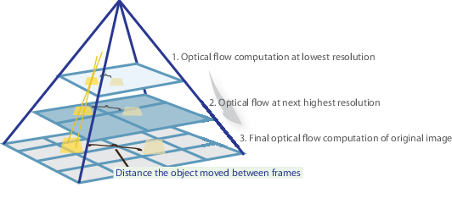
Pyramid KLT Tracker

Slide 22
Mean-Shift Tracking
Used for tracking objects in video sequences
Non-parametric technique
Operates in the spatial domain
Iteratively shifts a window (kernel) towards the mode (peak) of the probability distribution of pixel intensities.
Particularly popular for its simplicity and effectiveness in tracking objects with varying shapes and appearances.
Widely used in real-time tracking applications:
Video surveillance
Object recognition
Human-Computer interaction.

Slide 23
Mean-Shift Tracking: Steps
Initialize a search window around the target object in the first frame of the video. This window is often represented by a rectangular region.
Compute the probability distribution of pixel intensities within the window using kernel density estimation.
Calculate the mean shift vector by finding the weighted mean of pixel intensities within the window.
Shift the search window in the direction of the mean shift vector.
Iterate steps 2-4 until convergence or until a predetermined stopping criterion is met.
The final position of the search window represents the estimated location of the tracked object.

Slide 24
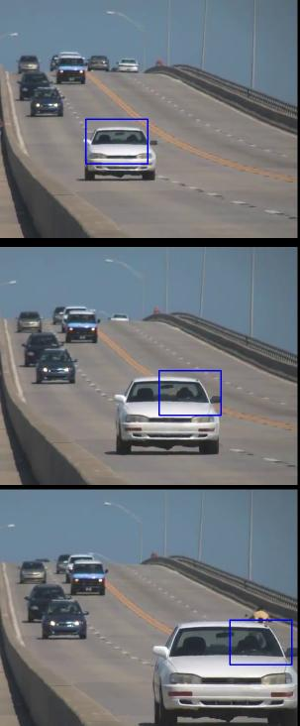
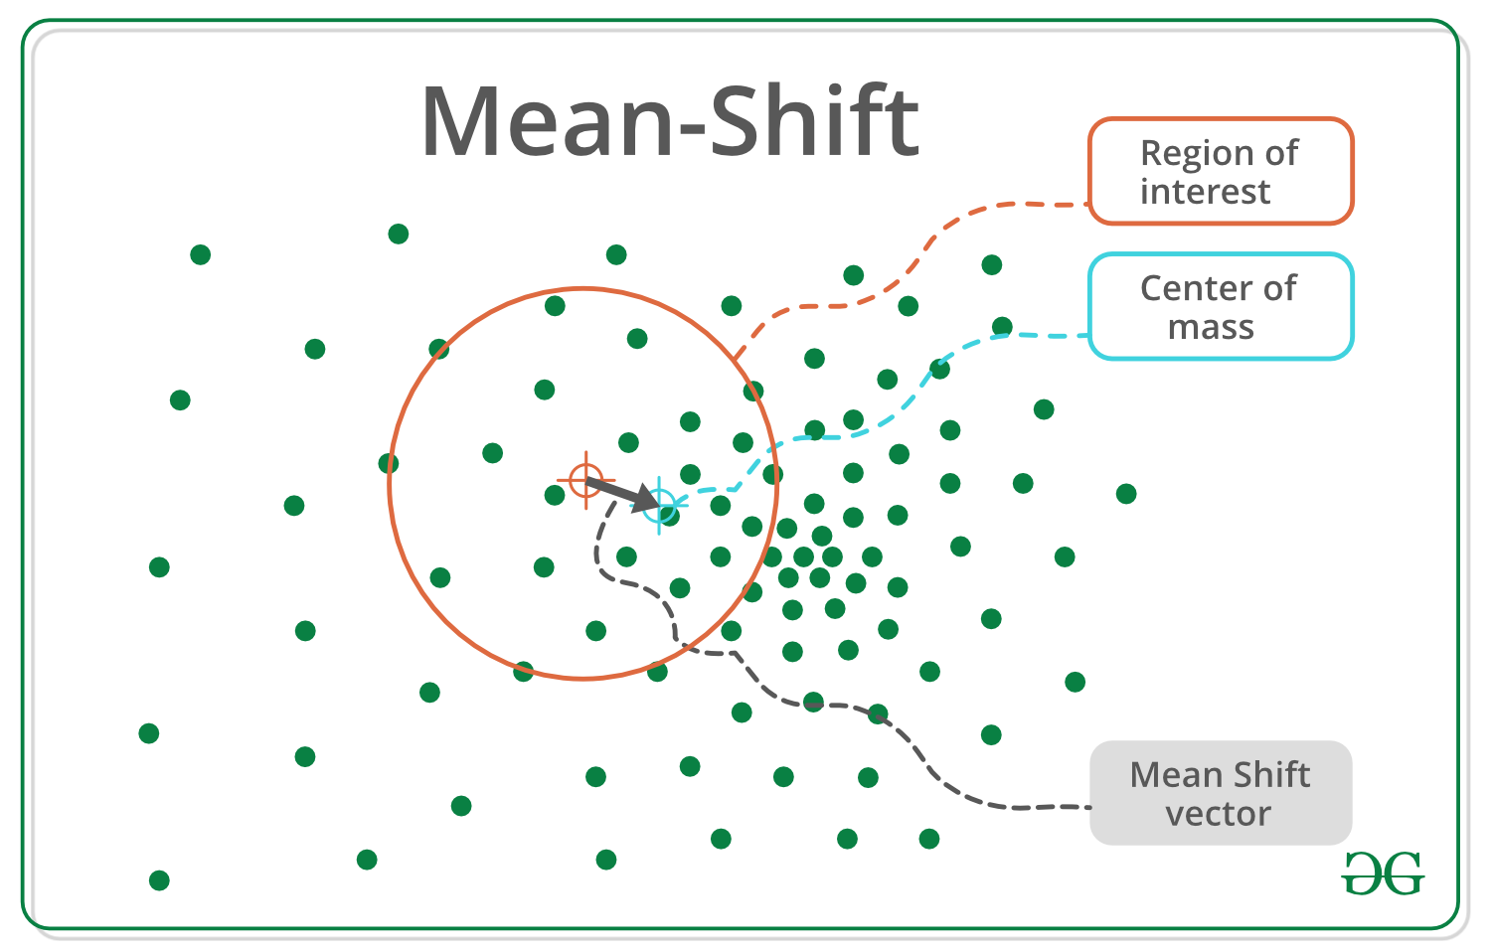
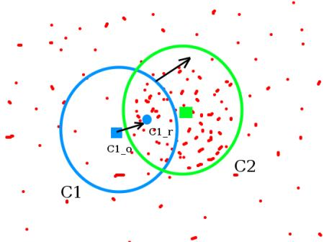
Mean-Shift Tracking

Slide 25
Applications and Challenges
Applications
Challenges
Object Tracking
Augmented Reality:
Anchoring virtual objects to real-world points.
Video Stabilization:
Stabilizing shaky videos by compensating for camera motion.
Gesture Recognition:
Tracking features on a person's hand or body.
Structure from Motion:
Reconstructing 3D scenes from a sequence of images.
Issues such as:
Occlusion
Illumination changes
Non-rigid deformations
Requirement of sophisticated algorithms and techniques to handle the issues

